Slide 1
Executive Functioning Skills
Retriever Integrated Health
Week 1

Slide 2
Welcome!
Confidentiality
  Be aware that this is not a counseling session and what you share here may not be confidential.
Logistics
  Two more sessions: 4/1 and 4/8
  Stand-alone but interconnected

Slide 3
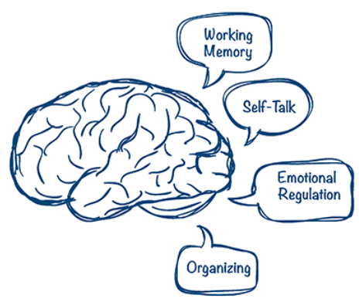
What is executive functioning?
Executive function refers to brain functions that activate, organize, integrate and manage functioning.
EF allows us to:
  Make decisions
  Be on time
  Remember things
  Know how to do things
  Cope with feelings and life changes
  Pay attention
  and so much more!
Remember: having Executive Functioning challenges does not mean you have ADHD. Everyone has some level of difficulty with one or more EF skills.

Slide 4

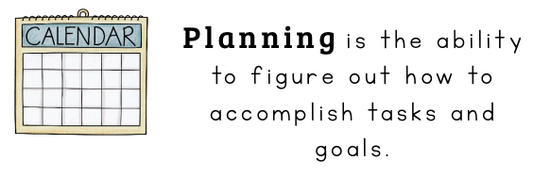
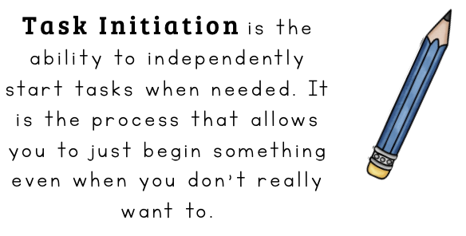


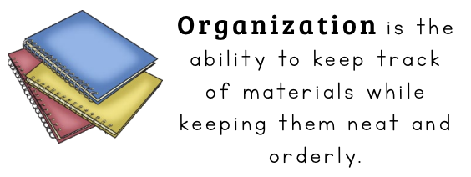
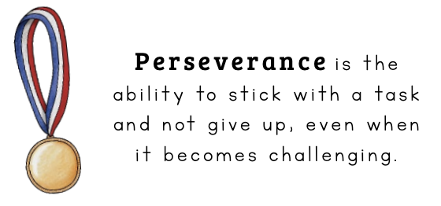
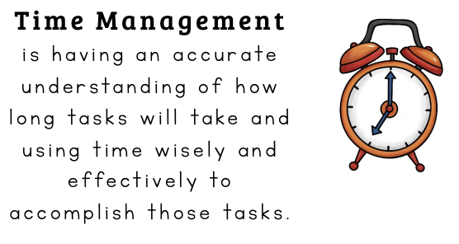
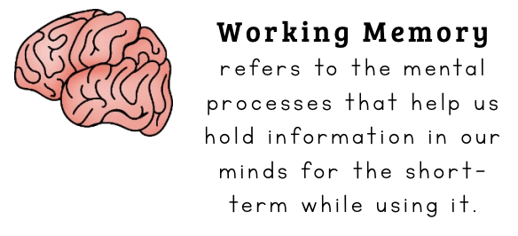
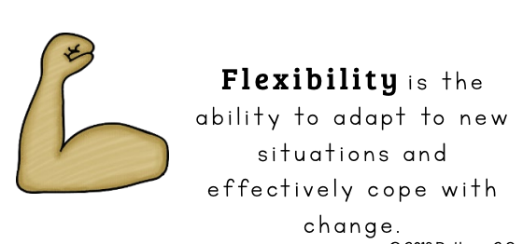
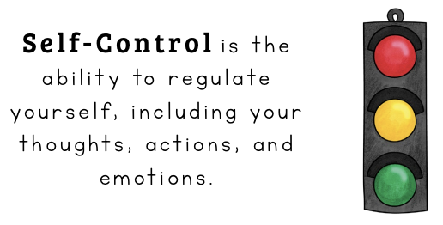
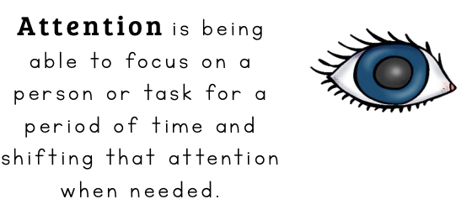
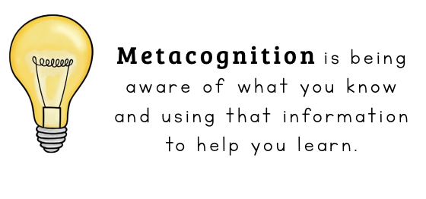

Slide 5
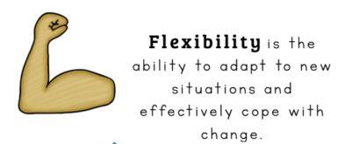
Agenda
Metacognition enables you to quality-control your thinking and reasoning and then redirect your cognition and behavior to improve your chances of successfully achieving your goals.
Why is this important?
Time management skills allow you to move through your day while efficiently completing the most important tasks. Effective time management reduces stress and increases your ability to spend time doing things that bring you joy.
Why is this important?
Flexibility eases the challenges associated with a world that is sometimes unpredictable and with challenges that are sometimes out of our control. It helps us to switch between tasks/activities, creatively problem solve, and to practice empathy and perspective-taking.
Why is this important?

Slide 6



Self-Assessment
I hurry through tasks just to get them done.
I dislike tasks or even fun things that require the use of problem-solving skills or extensive attention.
I have a hard time understanding my own role in the challenges I experience.
People have told me that I am unaware of how my behavior affects others.
I have a hard time starting assignments or chores early so they get done on time
I have a hard time fitting new events into my schedule.
I have a hard time accurately estimating how much time something will take.
I often miss due dates or deadlines for assignments or tasks.
I have a hard time handling unplanned changes to my schedule.
I have trouble transitioning between activities (and am often late because I get stuck in a transition activity).
I give up (sometimes temporarily, sometimes permanently) on tasks that I don’t accomplish the first time.
I have a hard time asking for help.

Slide 7
Metacognition
An objective, balanced, honest assessment that is based on facts (not on feelings or subjective assessment) AND the creation of a realistic-for-you plan for overcoming the result of that assessment
Metacognition is NOT: judgement, self-criticism, self-shaming, shame-driven, self-pity, making excuses

Slide 8
Metacognition
Activity: How I See Myself versus How Others See Me
Reflect:
  How difficult is it to be honest with myself about my strengths and weaknesses?
  What feelings make it challenging to be honest with myself about areas in which I need growth?

Slide 9
Personality Traits
Demanding
Thoughtful
Humble
Happy
Disagreeable
Simple
Fancy
Plain
Excited
Studious
Friendly
Shy
Impulsive
Inventive
Creative
Thrilling
Intelligent
Proud
Fun-loving
Daring
Bright
Serious
Funny
Humorous
Sad
Lazy
Dreamer
Helpful
Quiet
Curious
Reserved
Pleasing
Dependable
Tardy
Witty
Energetic
Cheerful
Forgetful
Easy-going
Supportive
Rude
Emotional
Loyal
Hardworking

Slide 10
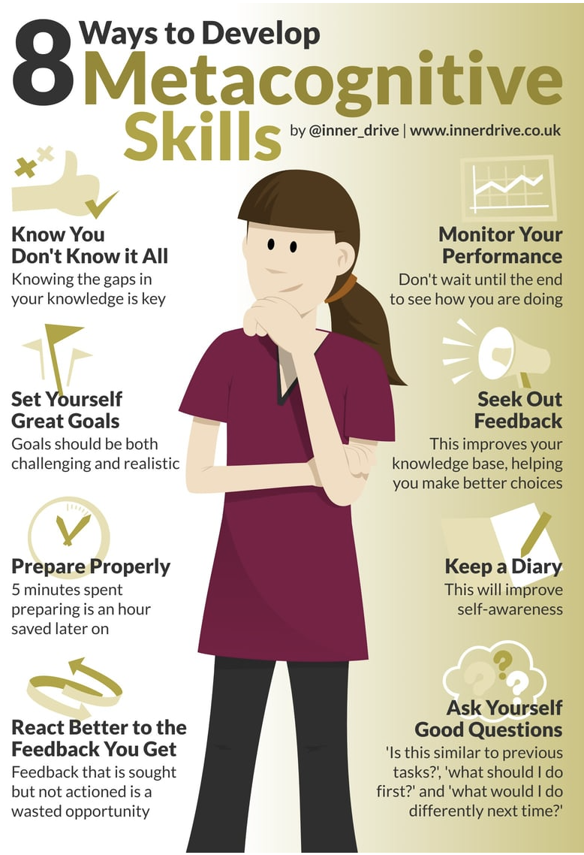
Metacognition
Tips
Self-reflection
  Is this the best way to carry out this task?
  Did I miss something about this?
  Am I looking at this in the right or best way?
  How can I do a better job at thinking about what I’m doing?
  How can I do better next time?
Get support in order to strengthen this skill:
  Ask a friend to look over an assignment or task to see if they see something you don’t
  Visit your professor during office hours to explore your thinking and get suggestions for improvement
  Ask a friend to walk you through how they would approach a task and see if it differs from how you did/would do it

Slide 11
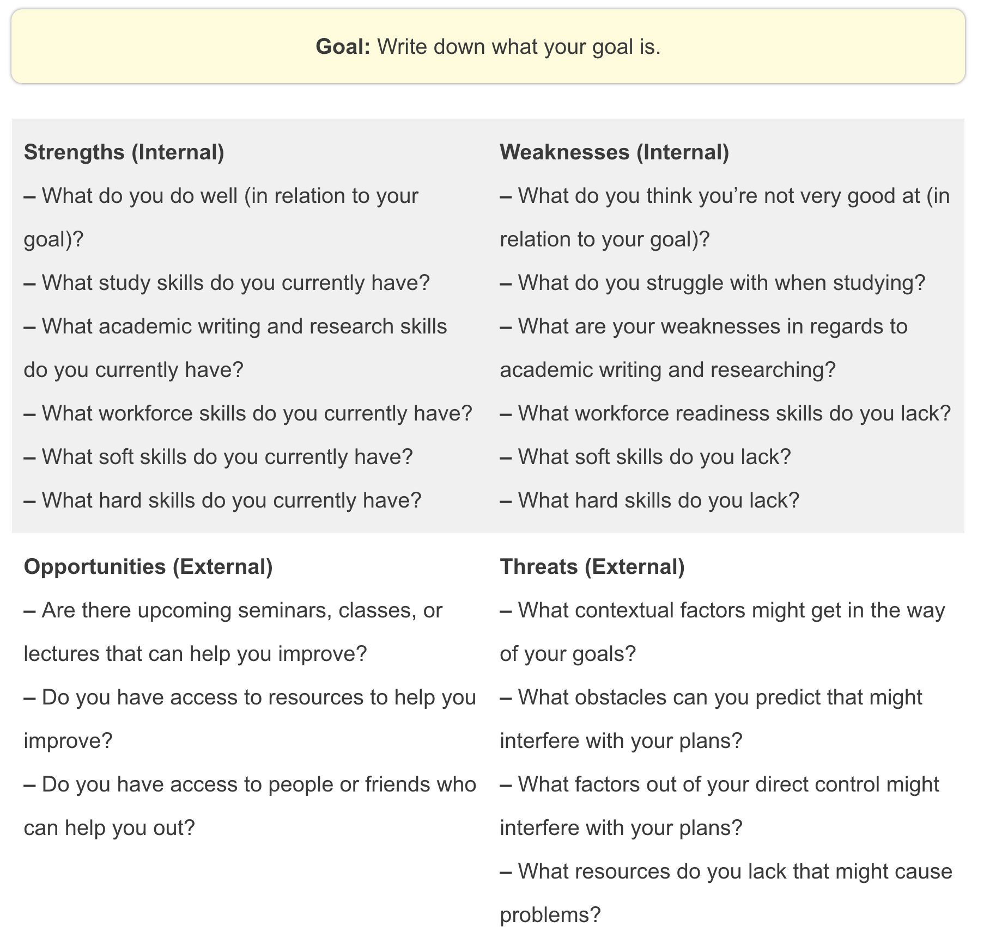
Metacognition
Tips
SWOT Technique

Slide 12
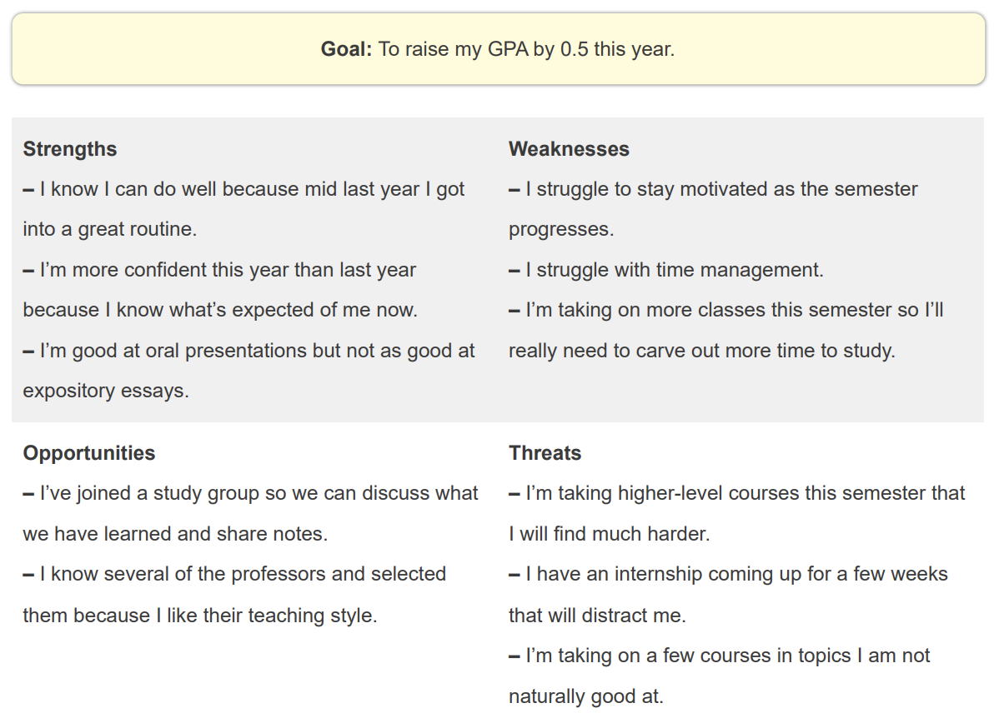
Metacognition
Tips
SWOT Technique

Slide 13

Time Management
Tips
Prioritization
  Rethink productivity
    Understand that not all tasks need to be addressed right now, and that not doing everything today does not mean you have a time management problem.
  Keep a master list of tasks (and update it regularly)
    Include “big” tasks/deadlines as well as “chunked” tasks/deadlines
Urgent
Important
General
    these are tasks that are on a deadline in a timeframe that feels pressing
    these are essential tasks that either do not have a true deadline or have a timeframe that decreases its priority
    these are non-urgent, non-essential tasks that will need to be done at some point

Slide 14
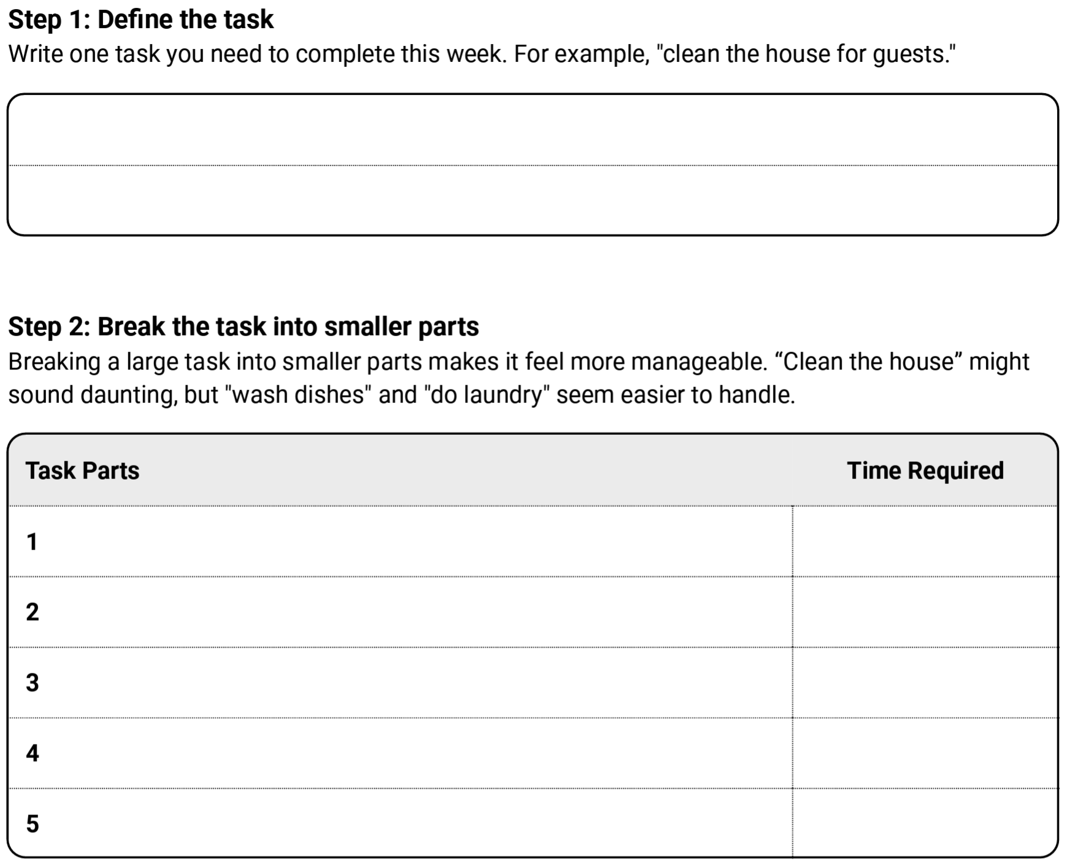
Time Management Tips
Chunk tasks and prioritize chunks
  Remember planning and preparation
  Double anticipated time if you’re unsure (or if this is a general challenge for you)

Slide 15
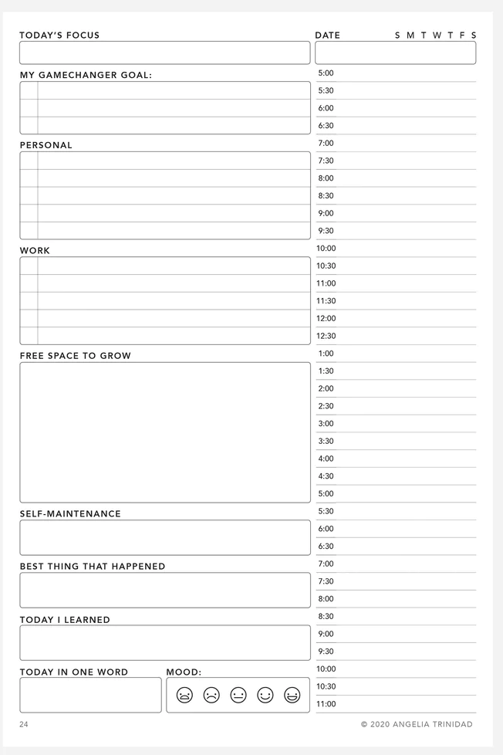
Time Management
Tips
Spend time planning
  Get a planner that works for you
  Each day, spend time planning your day
  Use metacognition here: time span, motivation, etc.
  If something gets missed, don’t add it back to your to-do list, reschedule it into your day/week
  Include travel time, prep time, etc.
  Build in breaks, free time, play time, and buffers
  Try using the one hour rule

Slide 16
Time Management Tips
Make time visible
  Leave yourself notes with what time you need to leave
  Ensure that there are visible clocks everywhere you need them
  Set alarms and reminders
  Hang a calendar up where you can see it with deadlines on it
Externalize motivation
  Tell a friend to hold you accountable to self-inflicted deadlines
  Use a body double
  Ask a friend to monitor reward systems

Slide 17
Tips to Improve Flexibility
  Emotion regulation
    Notice and accept feelings
    Give space for emotional reactions to things (big reaction vs. little reaction/big event vs. little event)
  Perspective shifting
    Negative thinking → positive or neutral thinking
    Looking at a situation from another person’s POV
    Priorities and shifting those in the moment (and moving away from everything all at once all the time)
    Values-driven decision-making and responding
  What I can control vs. What I can’t control
  Shifting into “what to do” from emotional reaction
    Focus on task rather than resistance to change
    Set a timer for resistance/reaction, then focus on task
Notes:
Helps to focus on tasks rather than fighting against reality

Slide 18
Tips to Improve Flexibility
  Plan A/Plan B
    When Plan A isn’t working, ask yourself about Plan B.
  Play with change in low-stakes situations
    Change your routine
    Try something new
    Practice perspective-taking with a friend or someone you trust
    Play a game with a new rule (make one up or change one)
    Solve a puzzle in a way that you usually don’t (inside pieces instead of edges? Columns instead of rows in Sudoku?)
Notes:
Helps to focus on tasks rather than fighting against reality

Slide 19
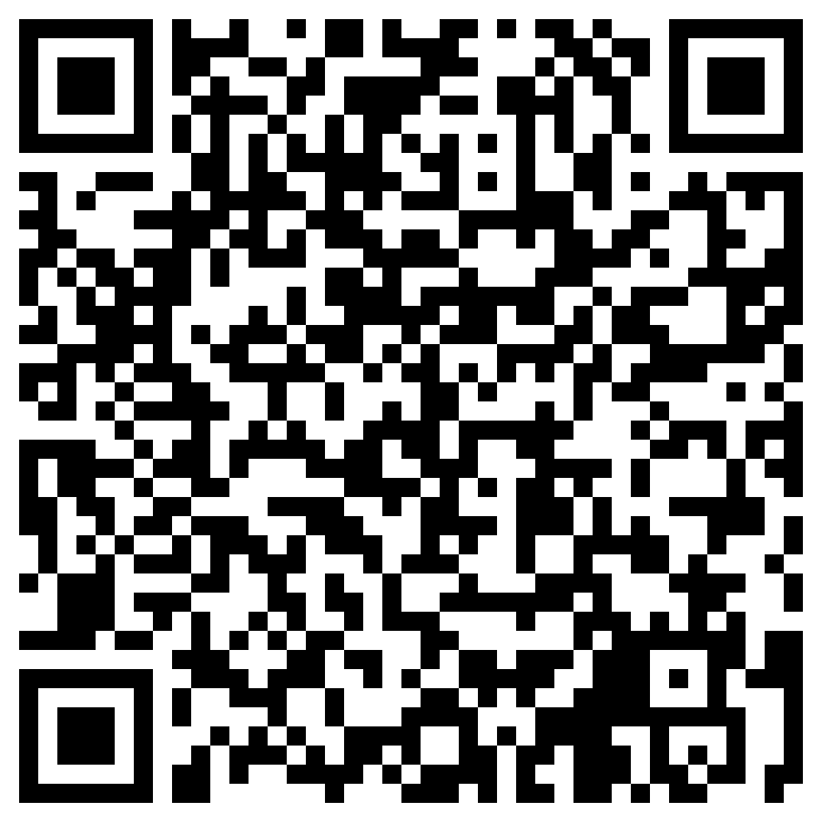
Wrap up
What is one thing you will do this week to improve your executive functioning?
Please don’t forget
to fill out our post-workshop survey!

