Slide 1

UMBC’s Money Smart Week:
A Clearview of my Personal Budget
LINDITA DIETZEN
APRIL 7, 2021

Slide 2
Agenda
Welcome!!!
Budget Component and Categories
Monthly Budget
Annual Budget Overview
Demonstration: Help a friend to build a Budget
Activity Build your Budget: Google sheet template
Resources and other Tools to help you build your budget
Questions

Slide 3
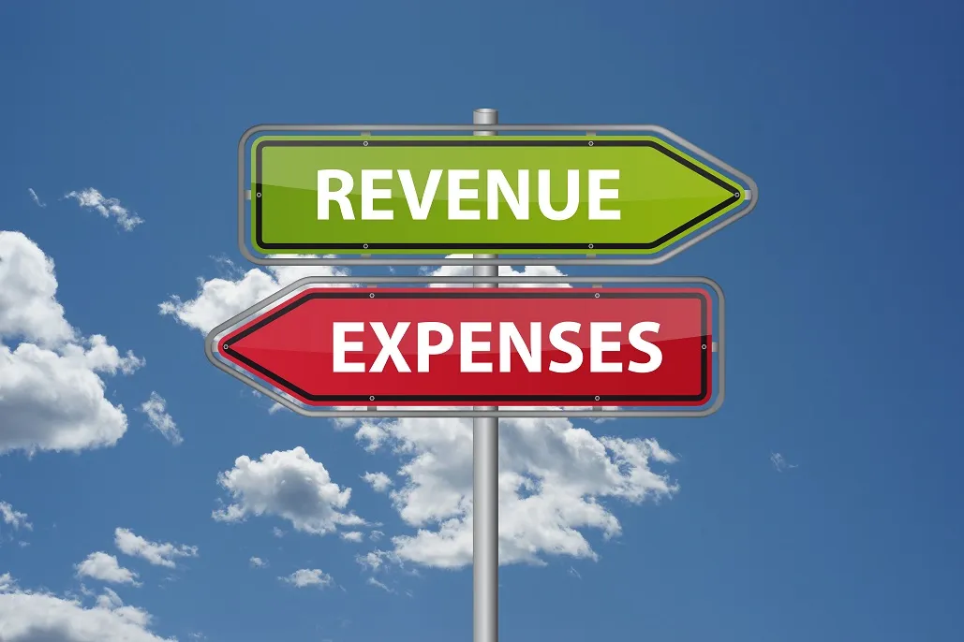
Personal Budget Components
Why Budget?
It helps us map where we are financially;
Helps us make informed decisions;
Set future goals: Short term, Medium term; Long term
It helps take actions
It helps us change spending habits
Reduces stress
Notes:
Budgeting is a process that requires a bit of time investment at the beginning but that will pay off later; Regardless of the tools you will use, the most important part is that you must include all your expenses and take methodical approach is best during this process. THere are two main company that we will try to unpack during the presentation today; Expenses vary from person to person; but there are few of categories that are general and hope that it will make sense

Slide 4

Sources of Personal Income:
  Your Salary/ Stipend;
  Partner/Spouse Salary;
  Parents Allowance;
  Financial aid/ Other Loans;
  Government:
    Tax return
    Covid-19 Stimulus;
  Other Interest Income:
    Savings; CD’s Bonds
  Other sources:
    Tutoring;
    Consulting
    Contract work

Slide 5
Categories of Expenses
Regular Bills
  Reoccurring
  Set or Specific Due date
  Easy to Estimate $ amount
  Considered a necessity
Other Regular Expenses
  Necessary expenses;
  No due date;
  Payment at the time of service;
  Some flexibility on the timing and the amount;
Other regular, not necessary
  Expense of choice;
  Once committed, it will occur in with a certain frequency at a due date
Infrequent
  Can be necessary
  Planned
  Unexpected

Slide 6
Expense examples
Regular Bills:
Other Regular Necessary Expenses:
Other Expenses :
Other infrequent:
Rent/ Mortgage
Groceries and home care ( food; Drinks; cleaning supplies; linens)
Entrainment:
Travel;
Utilities ( BGE and Water)
Personal and Pet care ( clothing and Hair cuts etc.);
Eating/ Drinking out
Gifts;
Car ( Payments and Insurance)
Commute: Gas for you car and or Other related expenses;
Subscriptions:
  Gym;
  Newspapers
  Apps
  Donations
Medical
Cell Phone Service
Medical or Prescription
House/Car repairs
Internet Connection

Slide 7
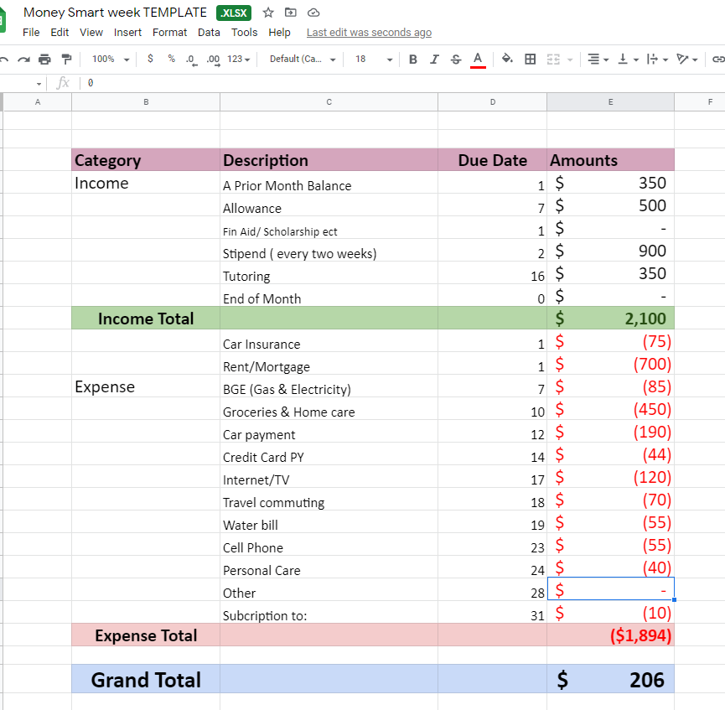
How and where do we start?
What drives your cycle of income and expenses ?
  weekly
  biweekly
  Monthly
  Semester
A current month or the following;
  Open your bank account
  Review the statement (s) including credit cards spending
  Add your balance at the Beginning
  Start categorizing each expense
  How much many do you have left

Slide 8
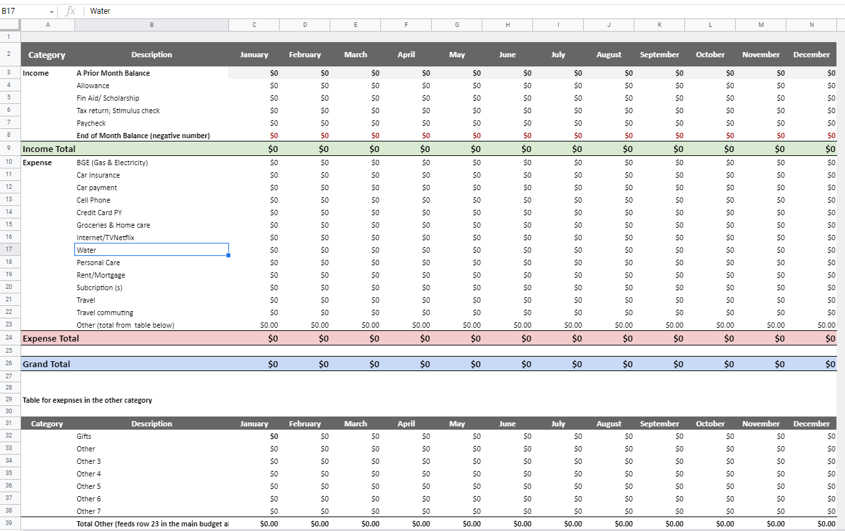
Annual Budget Template
Notes:
This template is in Google sheets; if later, you decide to use an app link Mint or the one that your bank may offer, this the spreadsheet will serve as a guide to make sure you have all the information;

Slide 9
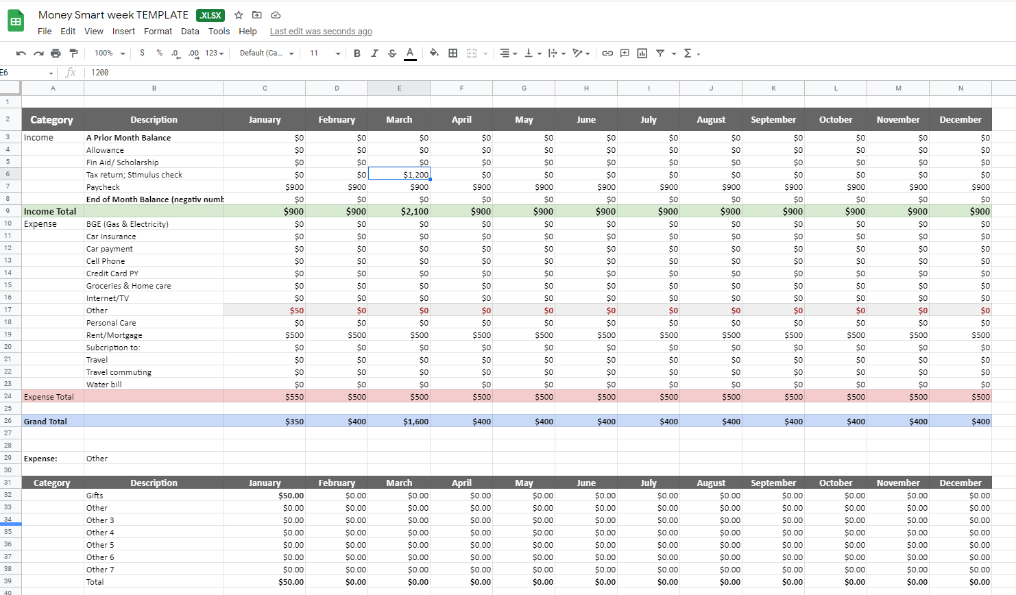
Annual Budget Overview

Slide 10
Demo: Let’s build a Budget for a Friend
Template 1 Easy Template
  Budget: Easy template
  ( Recommended if you are just starting using this template)
Template 2 Advanced Annual Budget Template:
Budget: Complex template
( Best to be used if you are familiar with google sheets Pivot table features)
NOTE: Please feel free to save a copy of any of the templates on your personal Drive; for your own use

Slide 11
Other UMBC’s Resources
Budget template
Creating a Budget
UMBC Financial smarts

Slide 12

Congrats!
One full hour of listing to Budgeting process!

Slide 13
Questions?
Please feel free to reach out to lindietz@umbc.edu with any questions

Slide 14
Thank you for joining us today!

